Slide 1
Data Analysis Application

Slide 2
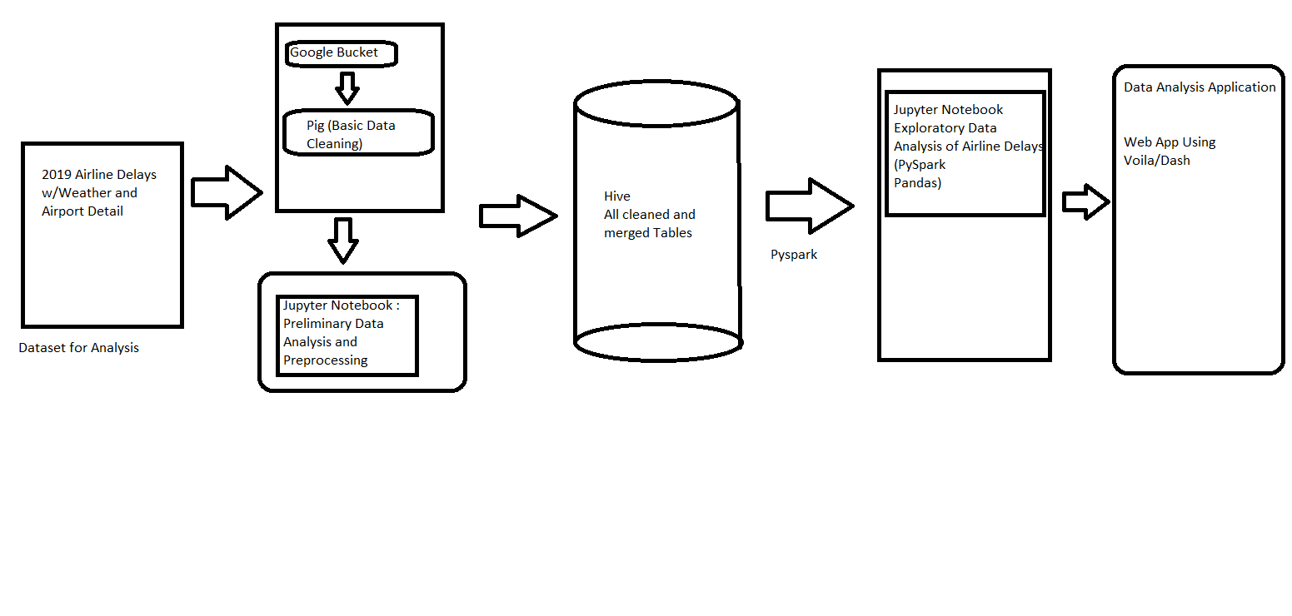

Slide 3
Dataset
The 2019 Airline Delays w/Weather and Airport Detail dataset was downloaded from Kaggle for the analysis. This dataset contains following raw CSV files:
airports_list
B43_AIRCRAFT_INVENTORY
CARRIER_DECODE
P10_EMPLOYEES
T3_AIR_CARRIER_SUMMARY_AIRPORT_ACTIVITY
AIRPORT_COORDINATES
airport_weather
Ontime Reporting (Multiple file as per months)

Slide 4
Cloud Infrastructure
Google Cloud Platform
Dataproc Cluster (1 Master 2 Worker Nodes)
Google Bucket
Pig
Hive
Spark
Jupyter Notebook (Modules: Pandas, Numpy, Seaborn, Folium, PySpark, Ipywidgets)

Slide 5
Challenges
Jupyter Notebook Buffer Memory
Java Component Gateway Error
Yarn Memory Issue

Slide 6
Exploratory Data Analysis
Correlation Between Departure delays with factors (weather, Late aircraft, Navigational delay, Carrier delay)
Top 50 Carriers with respective carrier delay percentage
Which top 50 Airports have the most delayed flights?
Flight navigation system (With Distance and Carrier info)

